Slide 1
Artificial Intelligence CS607

Slide 2
Course Logistics
Course representative (CR) can also collect course material from me after every lecture
Other students may get it from him
DON’T individually approach me for the material

Slide 3
Course Logistics Cont.
To get good grade you must:
Attend all the lectures
Read suggested material
A lot of programming
Attention DI students
Please help yourselves by studying
Bottom Line:
You cannot pass this course unless you study the material after every class

Slide 4
Course Objectives
Gives to a broad overview to the field of AI
Focuses on techniques and approaches that make computers more 'intelligent'.
To Excite you about the field

Slide 5
Recommended Books
Textbook
Artificial Intelligence A Modern Approach – 3rd edition by Stuart Russell and Peter Norvig
Reference Books:
Artificial Intelligence - 5th edition by George F. Luger

Slide 6
LECTURE 1
Introduction
Reading: Chapter 1

Slide 7
Outline
What is AI?
A brief history of AI
The state of the art of AI

Slide 8
What is Intelligence?
Ability of problem solving
Ability to think, plan and schedule
Efficient memory and information manipulation
Ability to tackle ambiguous and fuzzy problems
Ability to understand and perceive

Slide 9
Question
Is mouse intelligence?
It depends on context
Route planning

Slide 10
What is AI?
Views of AI fall into four categories:
Systems that act like humans
Systems that think like humans
Systems that think rationally
Systems that act rationally
In this course, we are going to focus on systems that act rationally, i.e., the creation, design and implementation of rational agents.

Slide 11
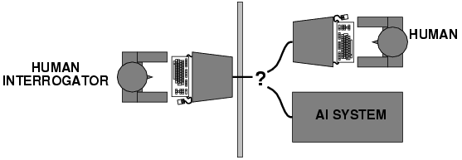
1. Acting Humanly: Turing Test
Turing (1950) “Computing machinery and intelligence”.
A computer passes the test if a human interrogator, after posing some written questions, cannot tell whether the written responses come from a person or from a computer.
Little effort by AI researchers to pass the Turing Test

Slide 12
Turing Test
Major Components of Turing Test:
Natural Language Processing: To enable it to communicate successfully in English.
Knowledge Representation: To store what it knows or hears.
Automated Reasoning: To use the stored information to answer questions and to draw conclusions.
Machine Learning: To adapt to new circumstances and to detect and extrapolate patterns.
Total Turing Test also includes:
Computer Vision: To perceive objects
Robotics: To manipulate objects and move about

Slide 13
2. Thinking Humanly: Cognition
Expressing the Theory of Mind as a Computer Program
General Problem Solver (GPS) (Newell & Simon 1961):
A program does not only need to solve the problems but should also follow human thought process
Requires scientific theories of internal activities of the brain.
Cognitive Science: Predicting and testing behavior of human subjects (Hypothesis based)
Cognitive Neuroscience: Direct identification from neurological data (Data driven)

Slide 14
3. Thinking Rationally: Laws of Thought
Aristotle: First to codify “right thinking”
Several Greek schools developed various forms of logic:
Notation and rules of derivation for thoughts
By 1965, programs existed that could, in principle, solve any solvable problem described in logical notation.
Problems:
Not easy to state informal knowledge in logical notation
Big difference between solving a problem "in principle" and solving it “in practice”
Problems with just a few hundred facts can exhaust the computational resources of any computer

Slide 15
4. Acting rationally: Rational agent
Rational behavior: doing the right thing
The right thing: the optimal (best) thing that is expected to maximize the chances of achieving a set of goals, in a given situation
Making correct inferences is sometimes part of being a rational agent
Advantages over other approaches
More general than the "laws of thought" approach
More obedient to scientific development than are approaches based on human behavior or human thought
Standard of rationality is mathematically well defined and completely general

Slide 16
This course is about designing
rational/intelligent agents

Slide 17
Summarized history of AI
1943 McCulloch & Pitts: Boolean circuit model of brain
1950 Turing's "Computing Machinery and Intelligence"
1956 Dartmouth: "Artificial Intelligence“ adopted
1952-69 Look, Ma, no hands!
1950s Early AI programs, including Samuel's checkers program, Newell & Simon's Logic Theorist,
1965 Robinson's algo for logical reasoning
1966-73 AI discovers computational complexity Neural network research almost disappears
1969-79 Early development of knowledge-based systems
1980-- AI becomes an industry
1986-- Neural networks return to popularity
1987-- AI becomes a science
1995-- The emergence of intelligent agents

Slide 18
The birth of Artificial Intelligence Dartmouth (1956)
2 Month, 10 Man, Study of AI
Newell and Simon came up with a reasoning program, the Logic Theorist (LT)
The program was able to prove most of the theorems in Chap 2, Principia Mathematica

Slide 19
State of the art
Deep Blue defeated the reigning world chess champion Garry Kasparov in 1997
No hands across America (driving autonomously 98% of the time from Pittsburgh to San Diego)
Google Driverless Car
During the 1991 Gulf War, US forces deployed an AI logistics planning and scheduling program that involved up to 50,000 vehicles, cargo, and people
NASA's on-board autonomous planning program controlled the scheduling of operations for a spacecraft
Proverb solves crossword puzzles better than most humans.

Slide 20
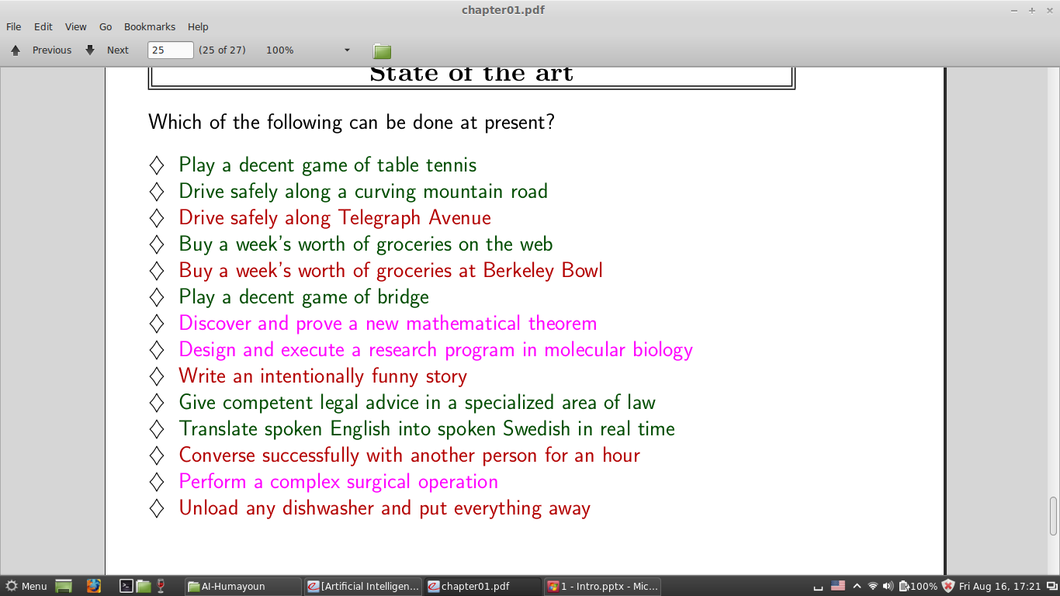
Another view of state of the art

Slide 21
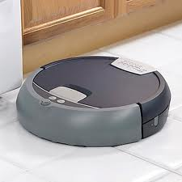
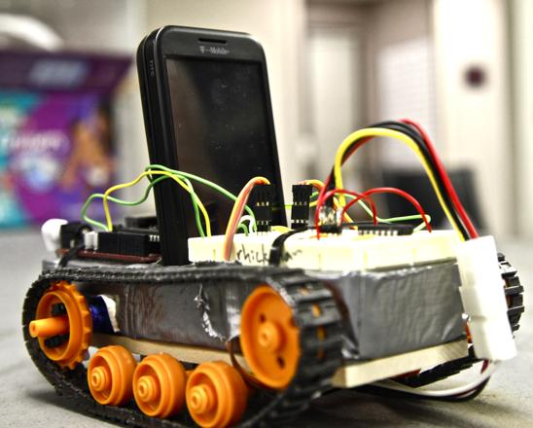
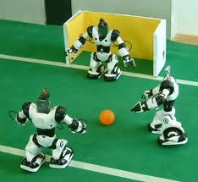
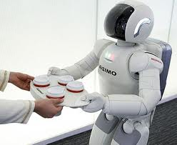
Robotics

Slide 22
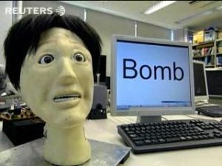
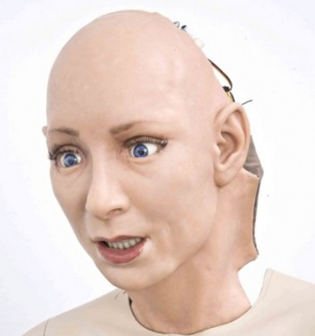
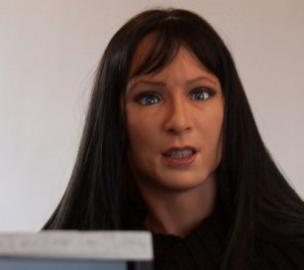
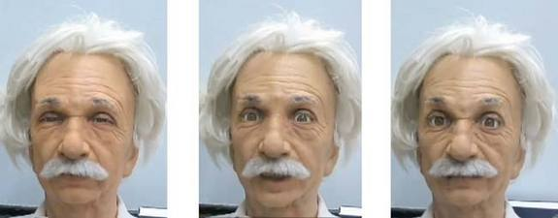
Robots with facial expressions

Slide 23
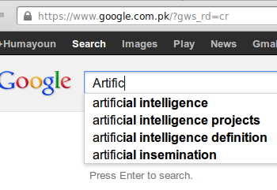
Natural Language Processing
Speech technologies
Automatic speech recognition (ASR)
Text-to-speech synthesis (TTS)
Dialog systems
Language Processing Technologies
Machine Translation
Information Extraction
Information Retrieval
Text classification
Spam filtering.

Slide 24
Others..
Computer Vision:
Object and Character Recognition
Image Classification
Scenario Reconstruction etc.
Game-Playing
Strategy/FPS games, Deep Blue etc.
Logic-based programs
Proving theorems
Reasoning etc.
Decision Support systems
Medicine, Weather forecast, Finance, etc.

Slide 25
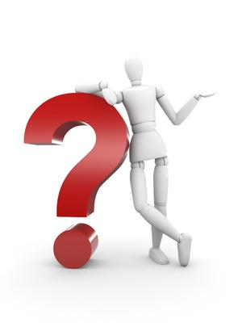
Questions

